Slide 1
Credit Model Rebuild
Nicholas Gecks-Preston Jesse Travaini | Ben Msambya
MXB344

Slide 2
Apollo Acquisition
Our peer-to-peer lending start-up has been acquired
They have deemed our current credit risk models inadequate
Requested a complete "ground-up" rebuild.

Slide 3
Mangement Concerns
How does your new model perform compared to the one you used previously? How can it be expected to perform on new loan applications?
What are the important variables in this model?
Can accounting for this variation (e.g., state/zip-code and time) improve performance benchmarks?
Are there any surprising differences in variables that are important for predicting credit risk, between your model with/without location and time information?
Does credit risk change over time or between states?

Slide 4
Data
Collection of Loan Data
Training Set of Loan Data
Validation Set of Loan Data

Slide 5
Covariates (repay_fail)
Available
"loan_amnt"
"term"
"int_rate"
"emp_length"
"home_ownership"
"annual_inc"
"verification_status"
"purpose"
Not Available
"credit_age_yrs"
"delinq_2yrs"
"dti"
"inq_last_6mths"
"last_pymnt_amnt"
"pub_rec"
"open_acc"
"total_acc"
"total_rec_int"
"total_rec_prncp"
"revol_bal"
"revol_util"

Slide 6
Exploratory Analysis

Slide 7
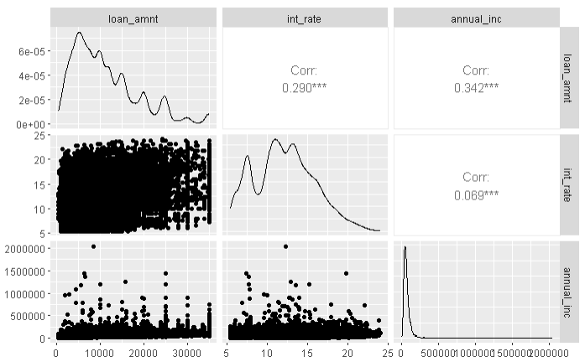

Slide 8
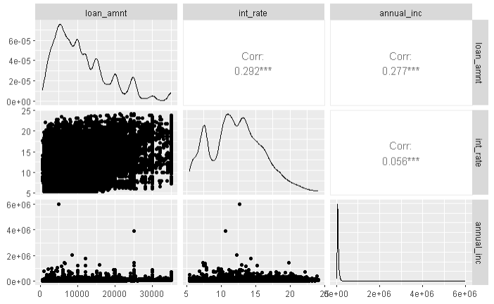

Slide 9
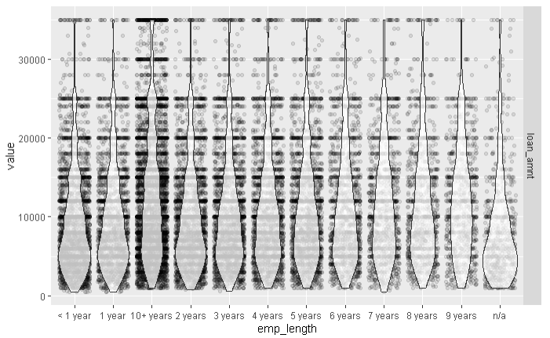

Slide 10
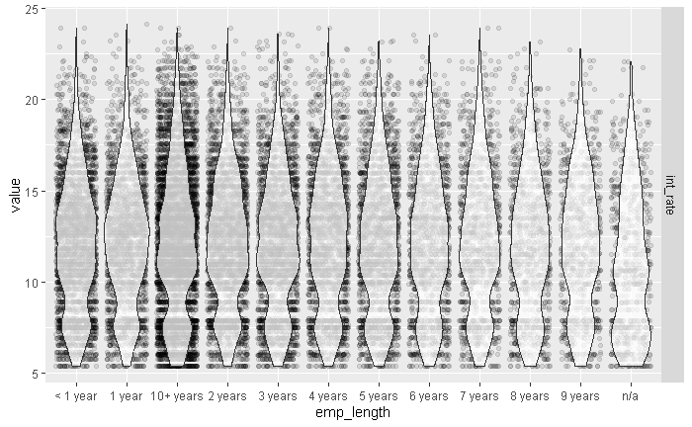

Slide 11
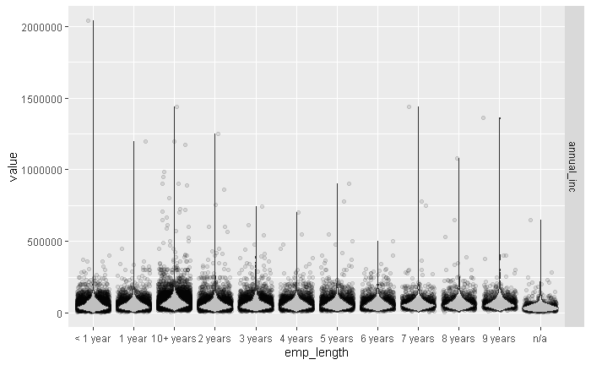

Slide 12
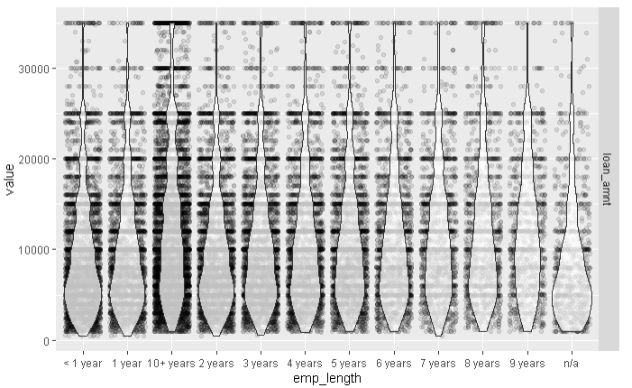

Slide 13
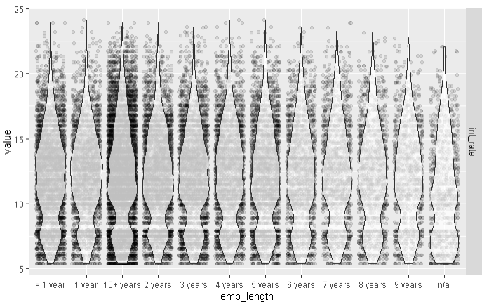

Slide 14
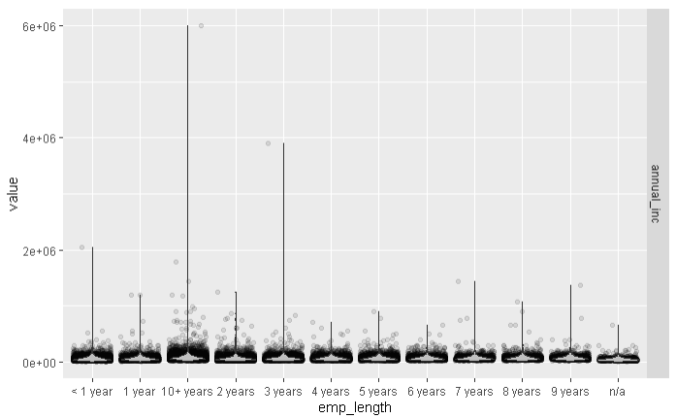

Slide 15
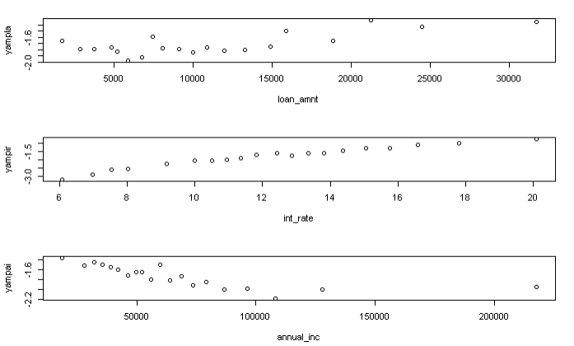

Slide 16
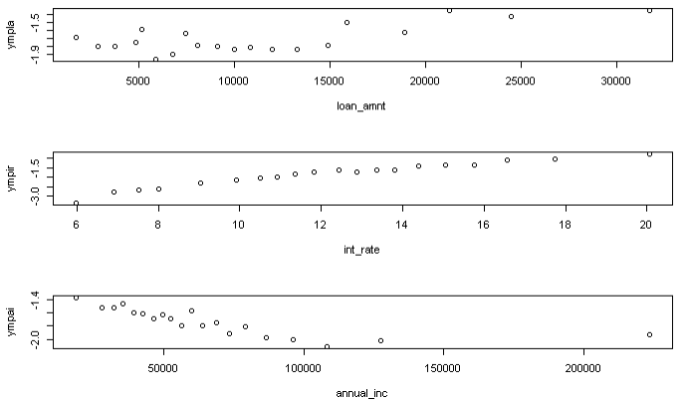

Slide 17
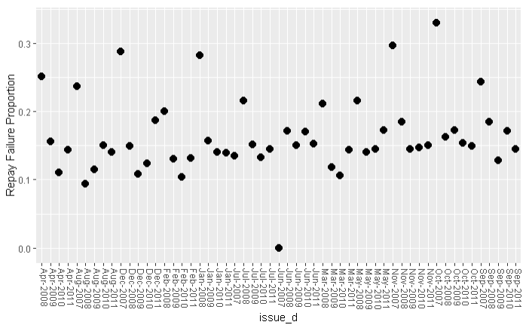
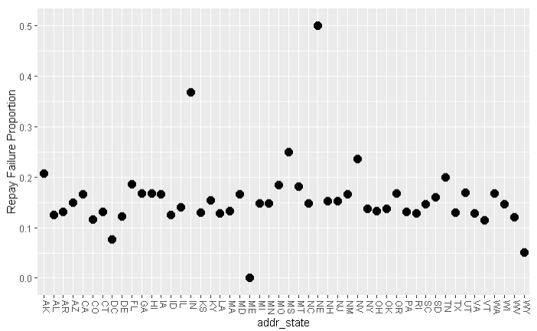

Slide 18
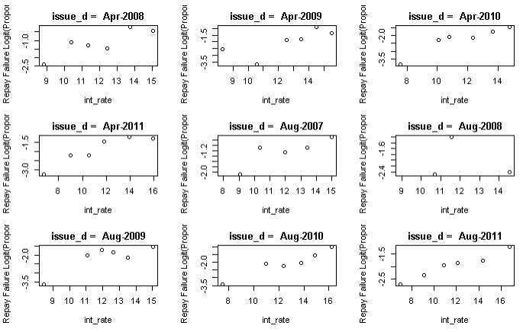

Slide 19
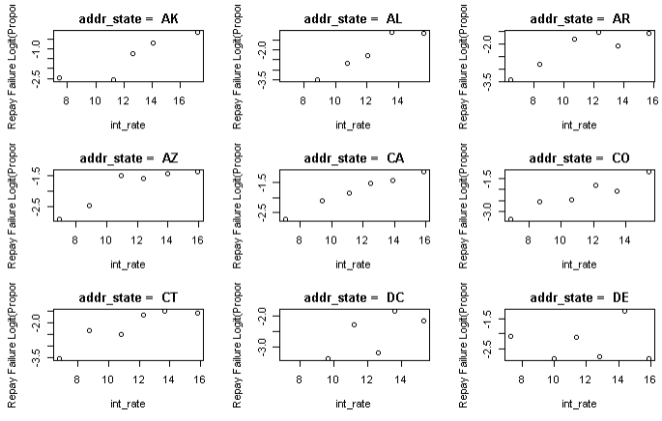

Slide 20
GLM Model

Slide 21
Initial Model Selection
annual_inc
repay_fail
term
purpose
verification_status
Based on domain knowledge and exploratory plots​

Slide 22
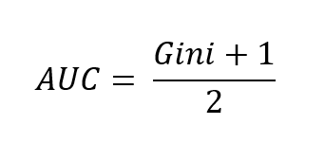
Gini to AUC

Slide 23
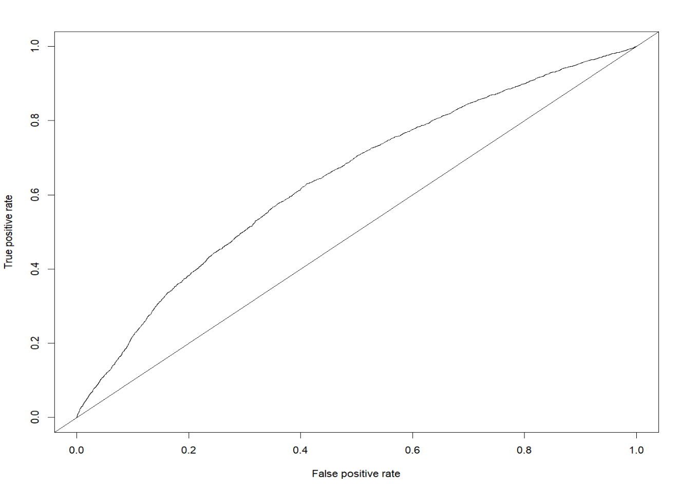
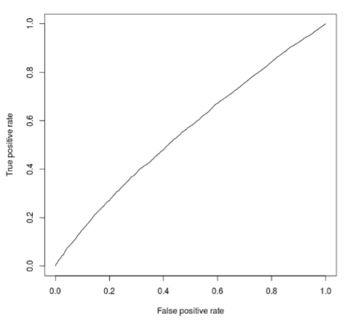
ROC Plot Training Data
AUC = 0.642
AUC = 0.557

Slide 24
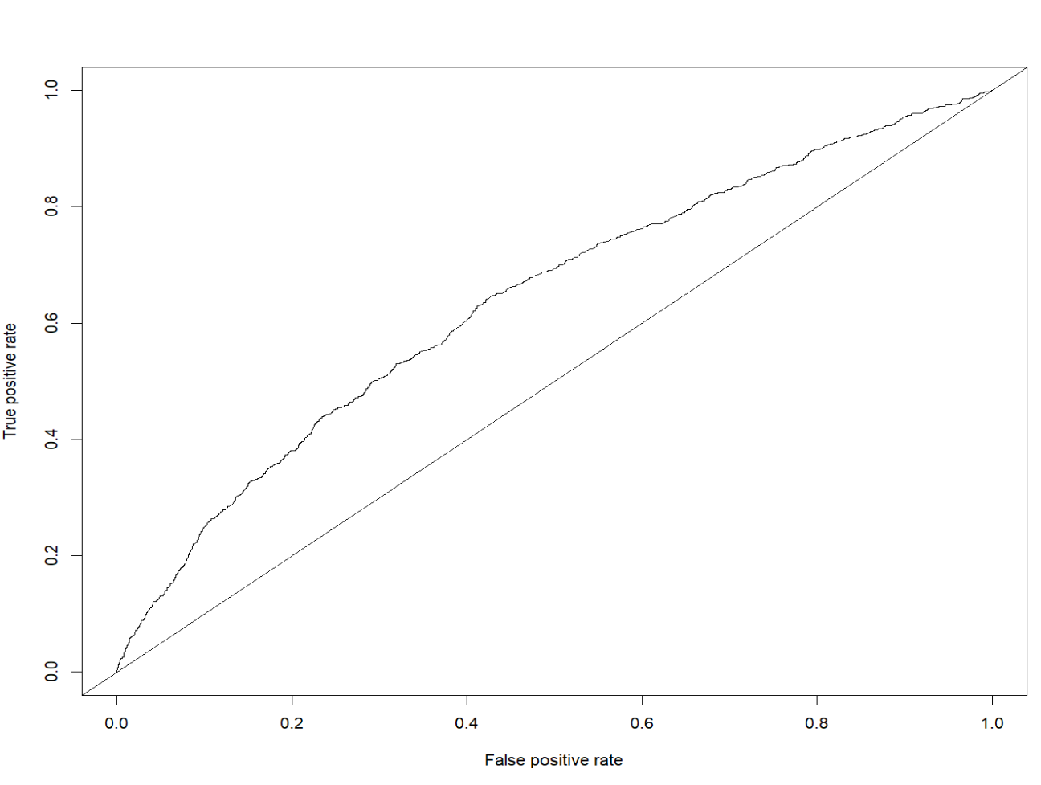
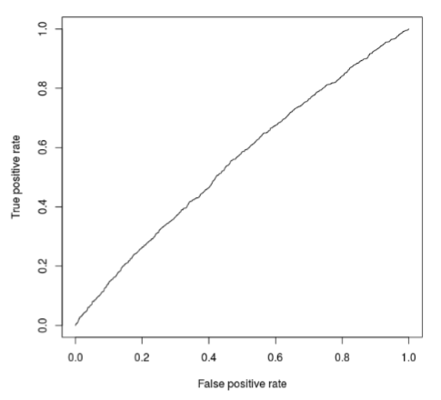
ROC Validation Data
AUC = 0.634
AUC = 0.555

Slide 25
Final Model Selection
Stepwise
Check Link function (cloglog, cannoical, probit)
BIC Comparison
AUC Comparison

Slide 26
The best model, so far...
annual_inc
repay_fail
int_rate
term
emp_length
purpose
verification_status
home_ownership

Slide 27
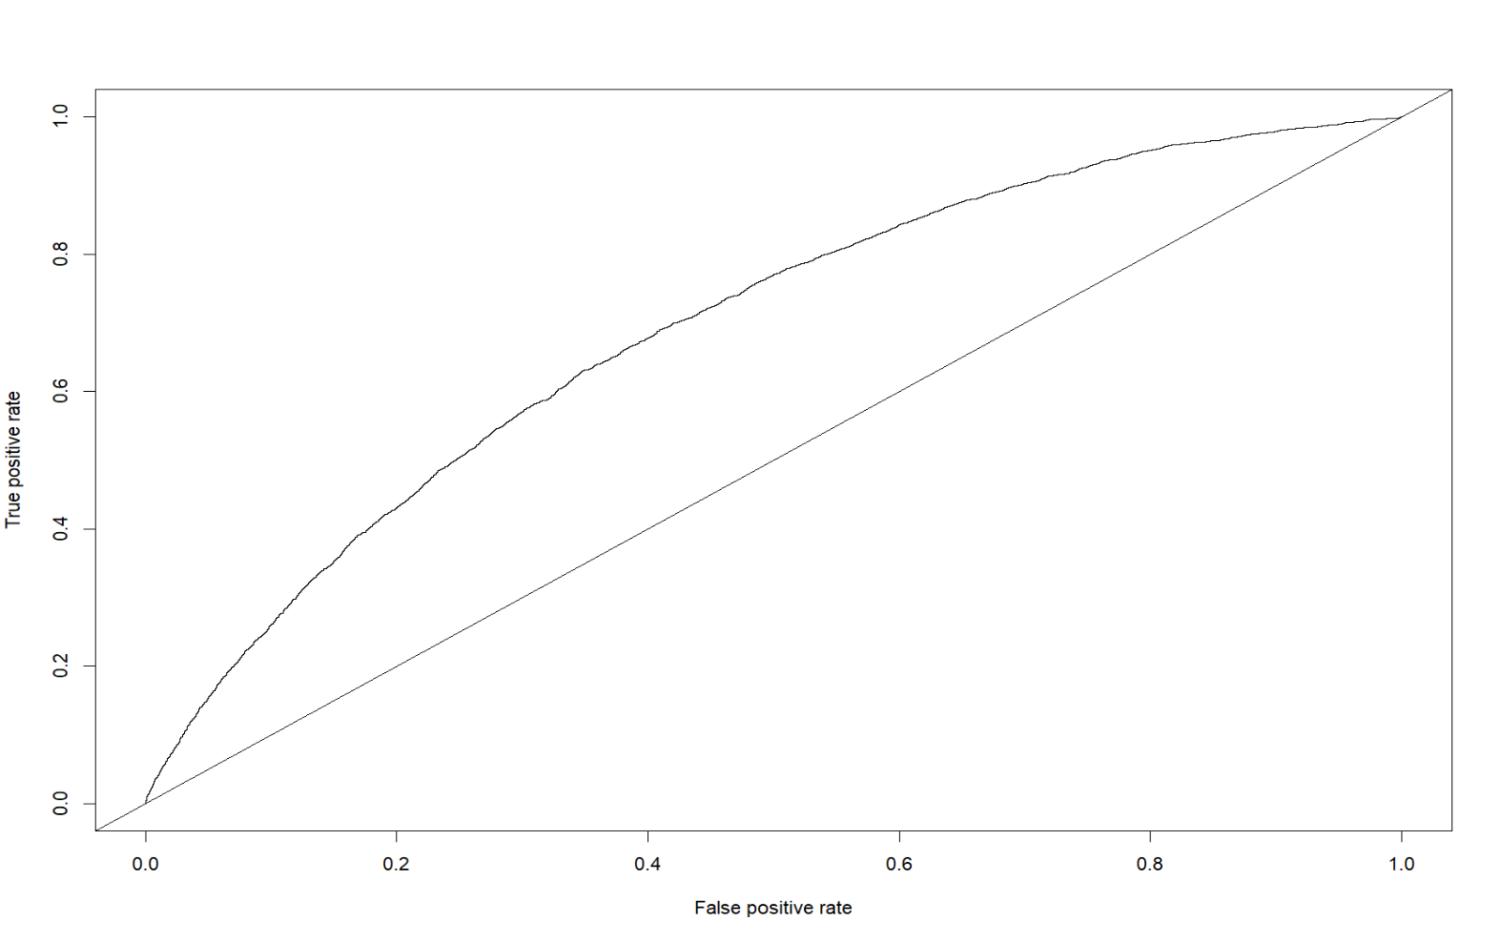
ROC Training Data
AUC = 0.691
AUC = 0.557

Slide 28

ROC Validation Data
AUC = 0.691
AUC = 0.555

Slide 29
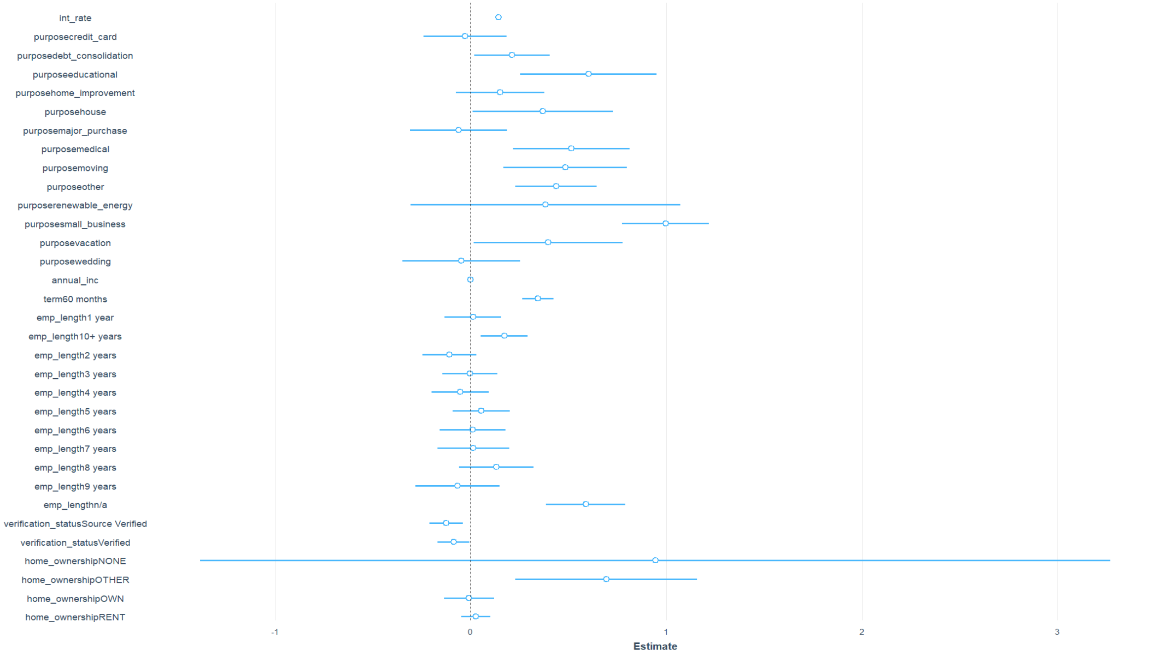

Slide 30

What is important
-Interest Rate
-Purpose
-Annual Income
-Term
-Verification Status
-Emp_length

Slide 31
Why Not home_ownership??
Only significant value is the 'other' status
01
Which only makes of the 0.329% of cases
02
Thus, It's importance is questionable.
03

Slide 32
GLMM Model

Slide 33
The Mixed Effects Model
annual_inc
repay_fail
int_rate
term
emp_length
purpose
verification_status
home_ownership
Random Effect - addr_state
Random Effect - issue_d

Slide 34
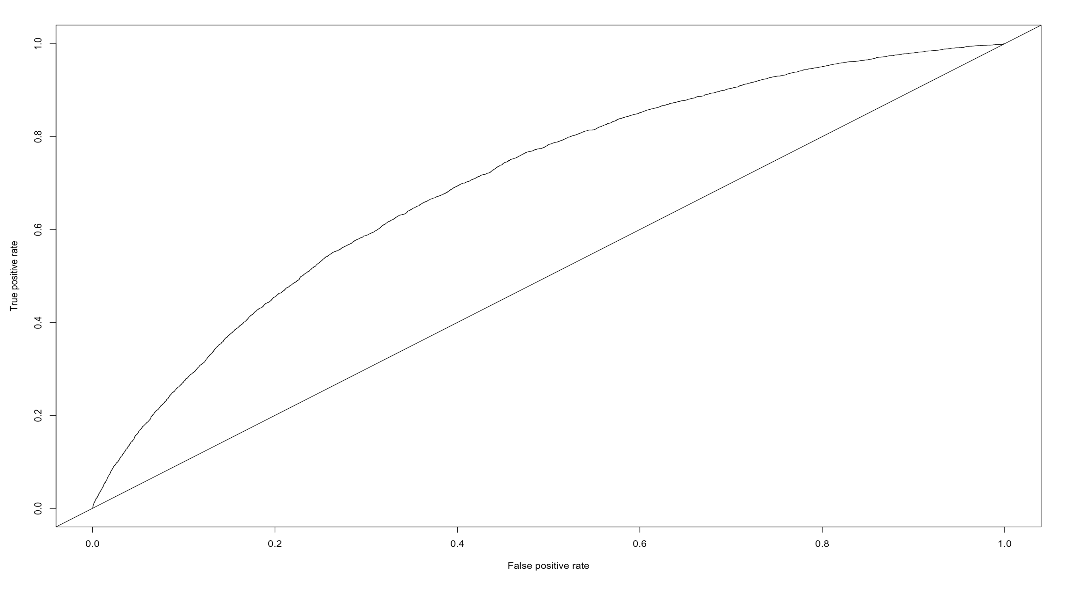
ROC
AUC = 0.701

Slide 35
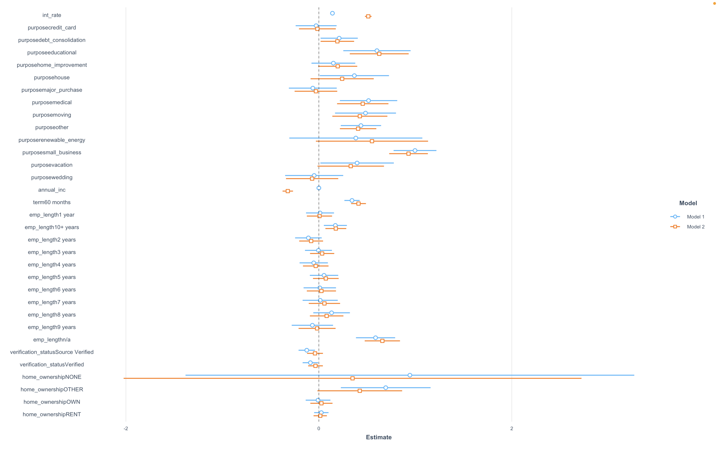
The Estimates
GLM
GLMM

Slide 36
What is important
-Interest Rate
-Purpose
-Annual Income
-Term
-Emp_length

Slide 37
Why Not Verification Status
Weird that default rate increases.
01
When controlling for random effects (time + location) not statstically signficant.
02
Therefore, this covariate is probably not important.
03

Slide 38
Conclusions
How does your new model perform compared to the one you used previously? How can it be expected to perform on new loan applications?
What are the important variables in this model?
Can accounting for this variation (e.g., state/zip-code and time) improve performance benchmarks?
Are there any surprising differences in variables that are important for predicting credit risk, between your model with/without location and time information?
Does credit risk change over time or between states?

Slide 39
What's Next

Slide 40
Appendix

Slide 41
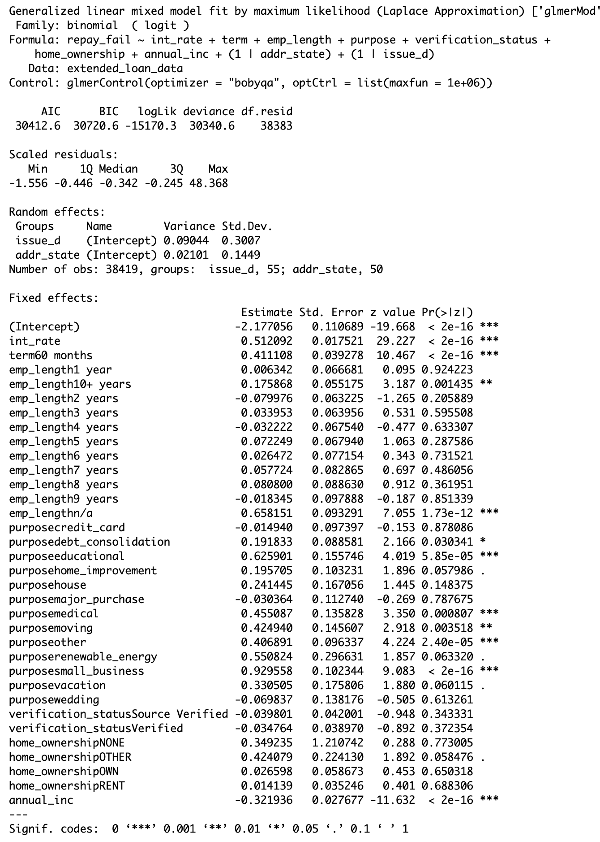

Slide 42
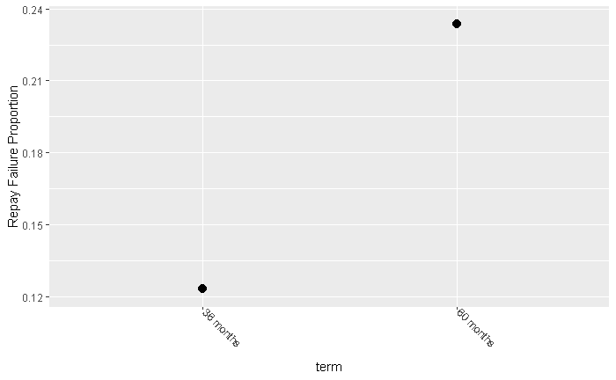
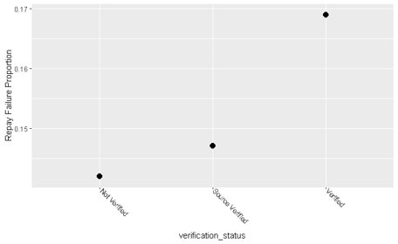
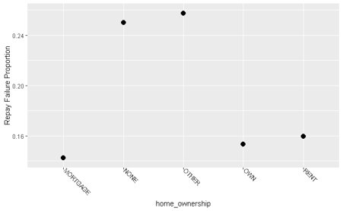
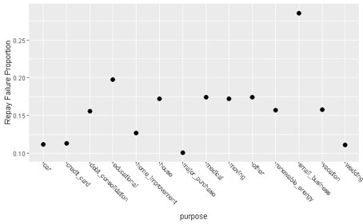

Slide 43
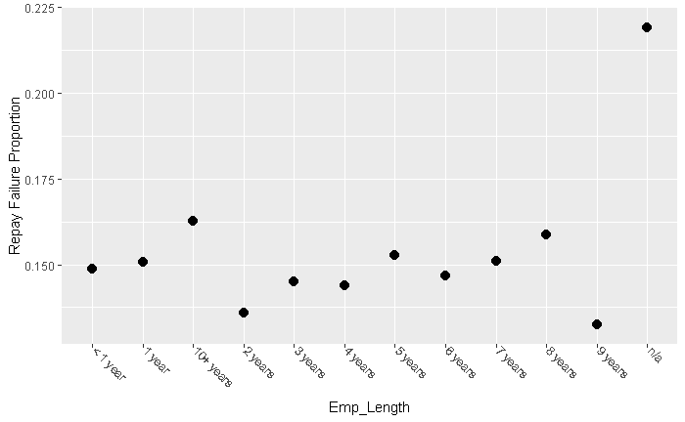

Slide 44

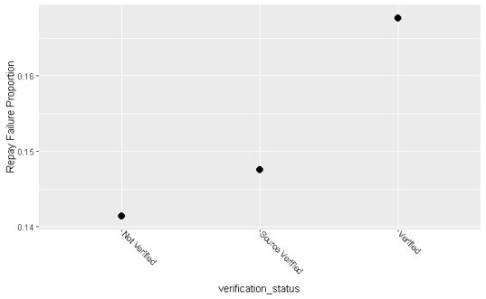
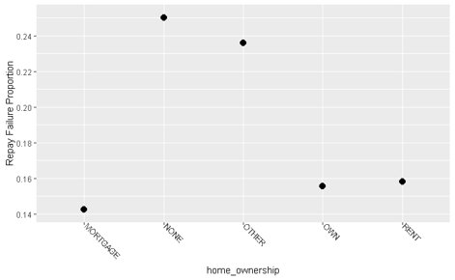


Slide 45
